Slide 1

BCTS (Business Area)
2022 Planting Contract
Viewing

Slide 2
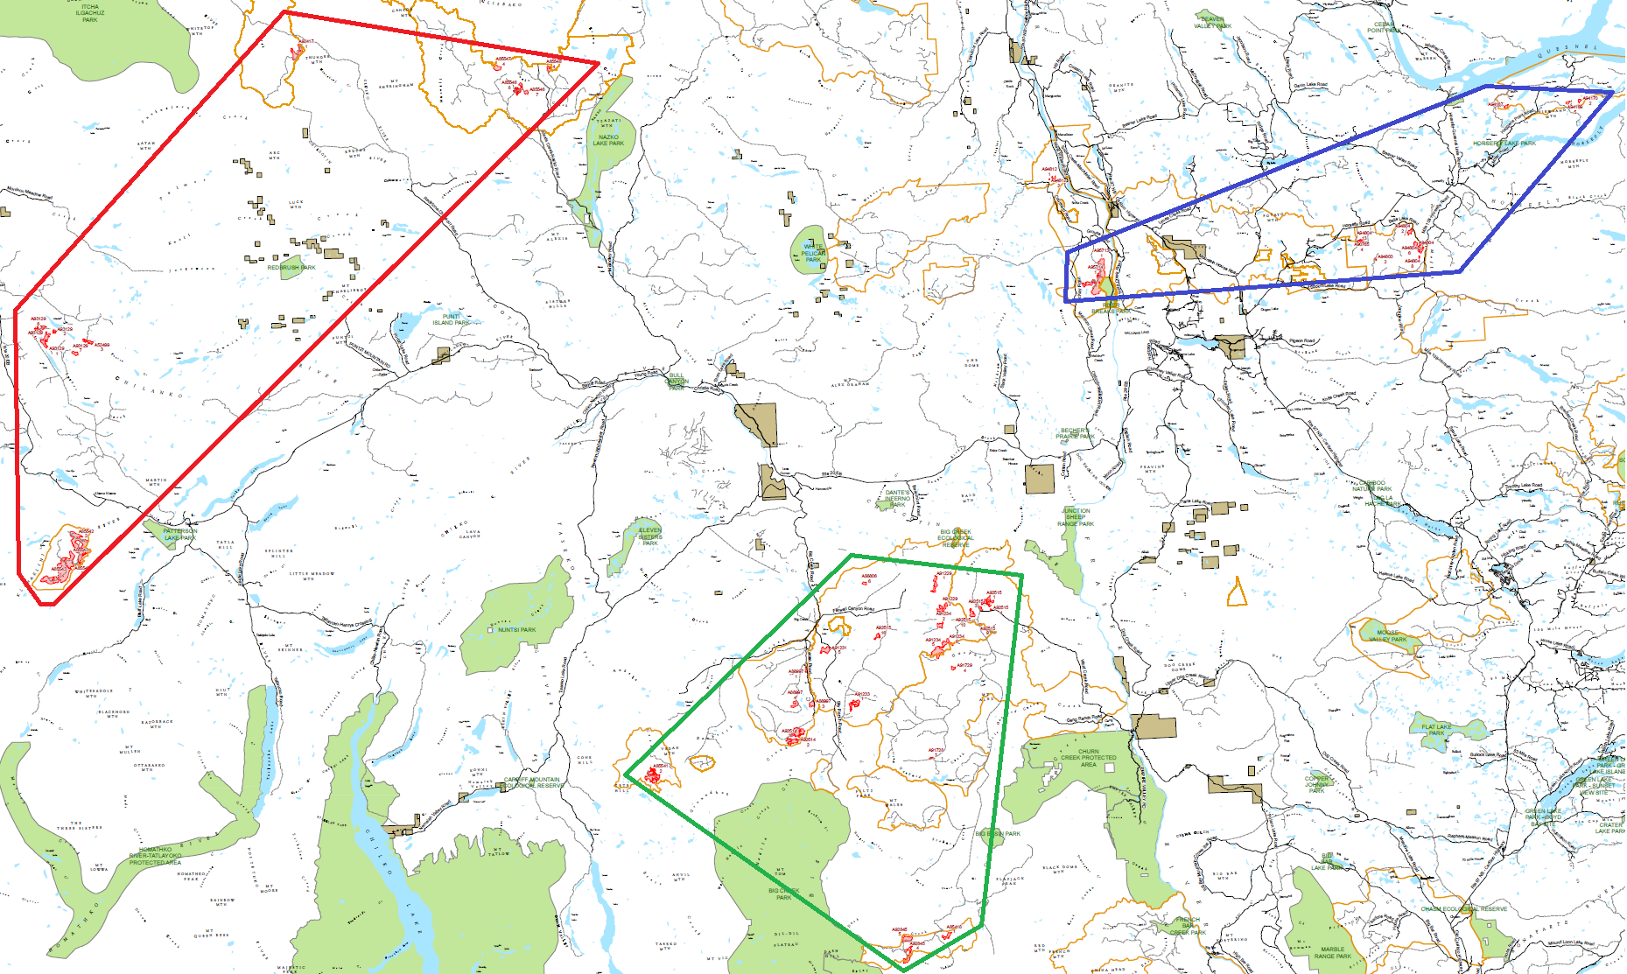
PL23TLE001
Meldrum & East of WL
PL23TLE006
Far West, Nazko
Williams Lake
PL23TLE005
Gaspard, Dash Creek

Slide 3
PL23TLE001 – Meldrum & East of Williams Lake
Viewland – 2 Mounded blks, ~64k trees
Wiggins Creek/Bells Lake
Disc, 21,400 trees
Meldrum – 2 blks Disc + Ripped, ~1.2M trees

Slide 4
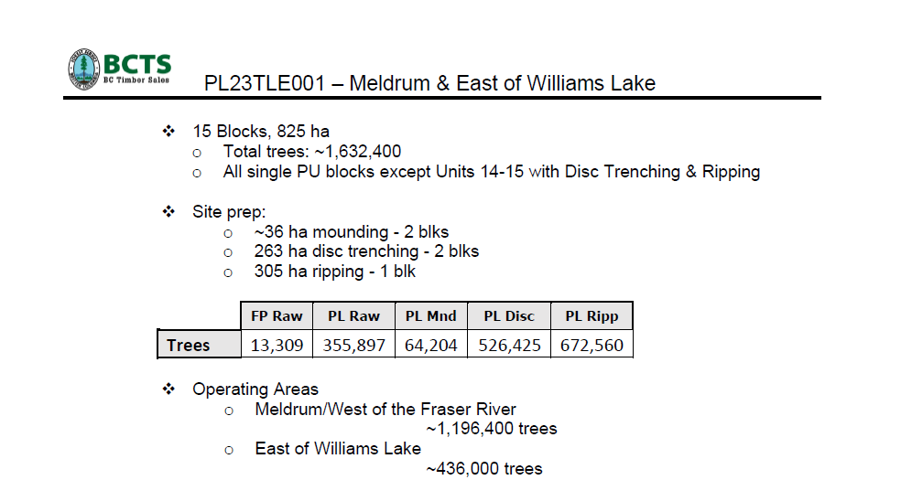
Stock Size 410, 412s

Slide 5
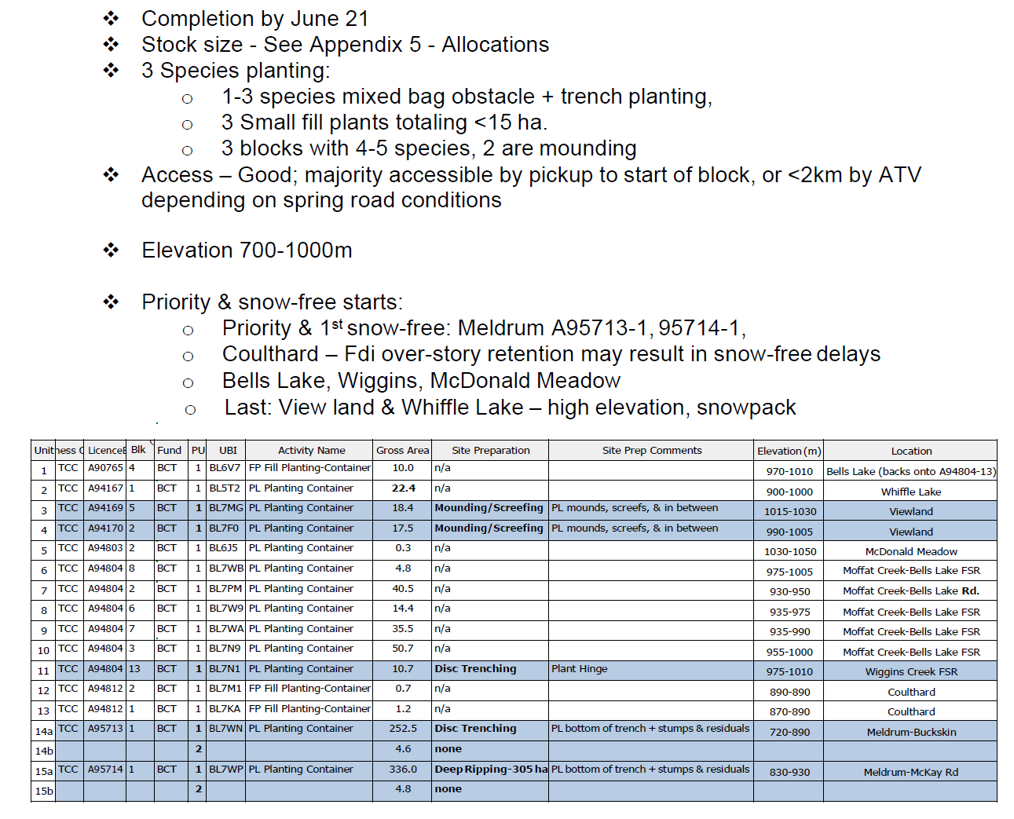


Slide 6
PL23TLE005

Slide 7
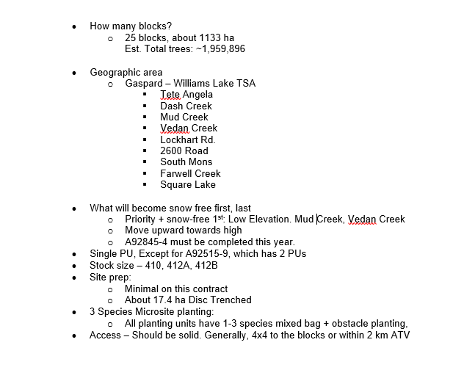
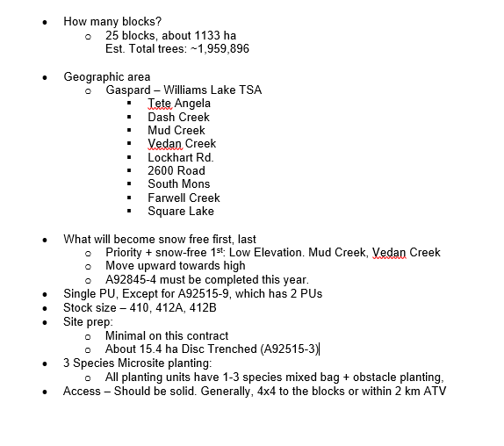

PL23TLE005

Slide 8
PL23TLE006

Slide 9
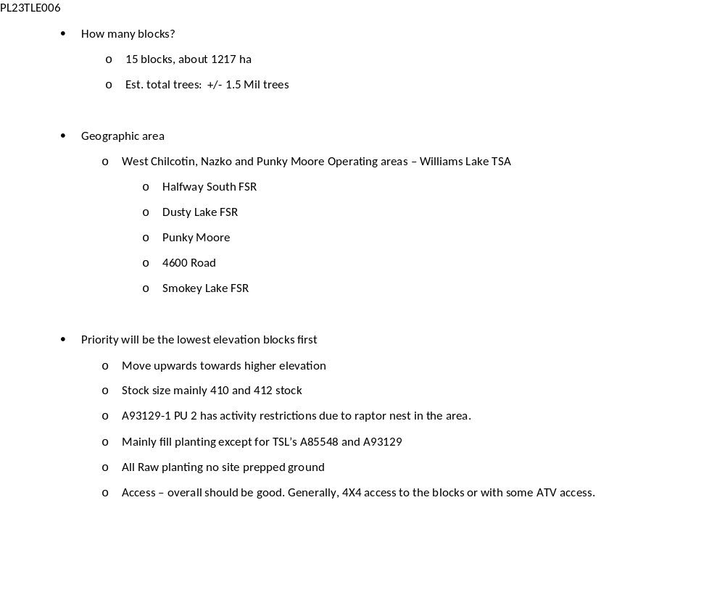

Slide 10
PL23TLE006

